Slide 1
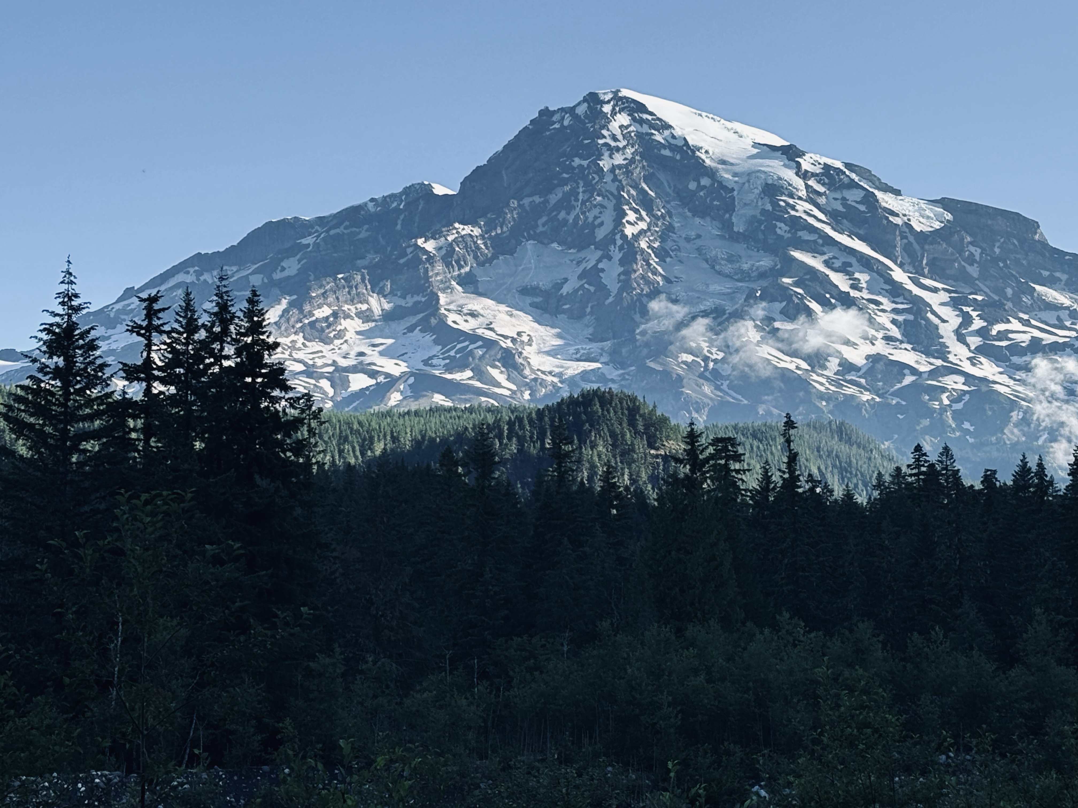
A Fine Balance’: Exploring the Interplay of Reproductive Strategies and Growth Dynamics in Trees
Xiaomao Wang
Oct 19 2025

Slide 2
Growth-reproduction trade-off
RESOUCES
Defense
Growth
Reproduction
Storage
Trade-offs help to maximize plants’ fitness when resources are limited
Notes:
Masting as a reproductive strategy featured with high variability in reproduction across years. A common question can be asked is that why tree developed such a reproductive strategy instead of producing same amount of seed every single year. We are all familiar with the predator satiation hypothesis, knowing that the big crop might maximize the seedling survival. However, another characteristics is that a big crop is followed by years of no crop or light crop, so we would wonder if there’s a trade-off between the growth and reproduction causing this pattern in masting.
Plants have limited resources and must actively allocate them to support survival and reproduction. How they allocate their resources is influenced by environmental factors and the plant’s life history strategy. Trade-offs are important for plant fitness because plants cannot maximize all aspects of their life processes with limited resources. Masting as a special reproductive event involving the production of lots of seeds in certain yar, it is intuitive to expect a growth-reproduction trade-off, with the growth of plants during masting years might be impacted. This relationship might be even more complex for conifer species, whose reproductive cycles typically last for two years. In this chapter, I will combine growth data, seed trap data and climate data to explore the relationship between masting and plant growth.

Slide 3


Masting hypotheses related to trade-off
Resource matching
Environmental cues
Notes:
There are two hypotheses potentially related to growth-reproduction trade-off, one is resource matching hypothesis, which indicate that when more resources are available, trees are able to allocate more resources for reproduction, that’s why we observe the masting events. Another hypothesis is environmental cues, indicating that certain environmental cue triggers the mast. We could interpret this as, certain environmental cue determines more resources are either going to growth or reproduction, in this case, we would expect to see a trade-off, eg: environmental cue triggering masting will result in less growth.

Slide 4
-
Growth
+
Masting
# Cones
# Seeds
Non-constant
allocation
Cues
Climate
Vetos
Non-masting
Growth
Constant
allocation
# Seeds
Growth
+
+
More resources
Climate

Slide 5
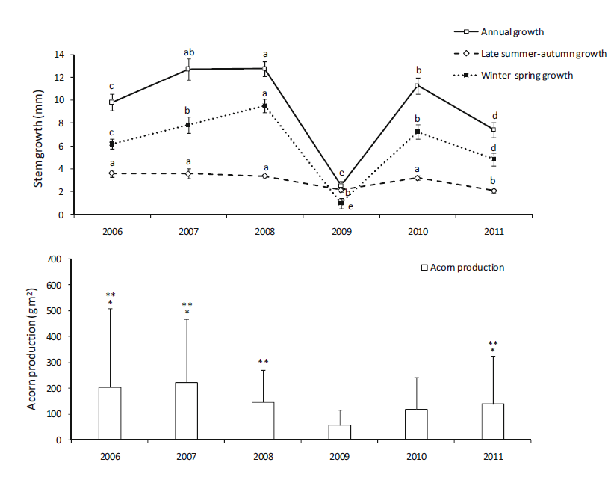
Previous studies
Martín, D et al., Trees, 2015
Notes:
There are some studies investigating the trade-off between reproduction and growth regarding masting years, and people have different conclusions.
There were trade-offs between acorn production and stem growth in individuals of Quercus ilex. There were negative correlations between acorn production and annual and late summer–autumn stem growth during masting years, but no relationship between acorn production and winter–spring growth.

Slide 6
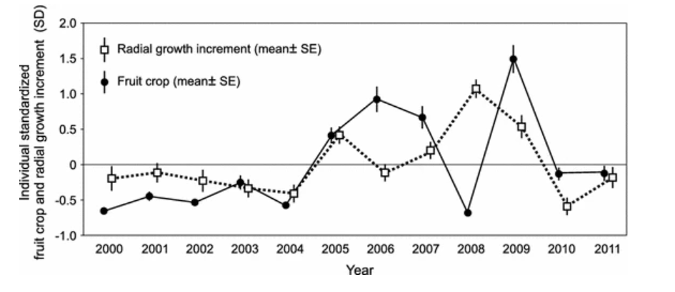
Previous studies
Żywiec, M., & Zielonka, T., Trees, 2013
Notes:
There are some studies investigating the trade-off between reproduction and growth regarding masting years, and people have different conclusions.
There were trade-offs between acorn production and stem growth in individuals of Quercus ilex. There were negative correlations between acorn production and annual and late summer–autumn stem growth during masting years, but no relationship between acorn production and winter–spring growth.

Slide 7
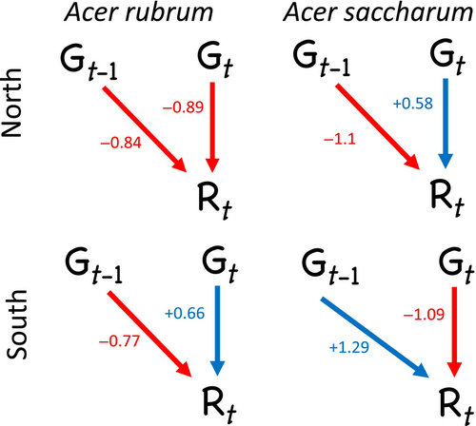
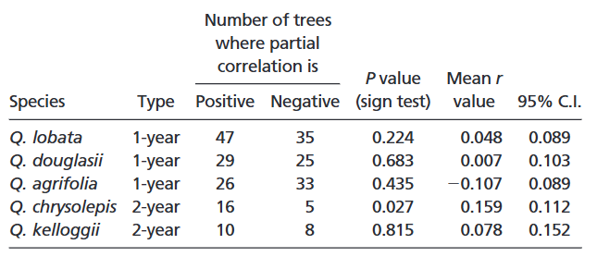
Previous studies
Vincent, C., & Ibáñez, I., Ecosphere, 2024
Knops, J. M et al., PNAS, 2007
Notes:
Climatic niche of mast seeding in beech, found evidence of a climate-driven trade-off between seed production and vegetative growth in beech. When conditions favor high seed production, vegetative growth tends to be reduced — and vice versa.

Slide 8
Previous studies
How important are the environmental factors in this relationship?
When does the determination of a masting year happen?
When does the maturation of seeds happen?
Notes:
From previous studies, we could conclude that the trade-off relationship might be complicated, and there are several things we need to consider when approaching this question.

Slide 9
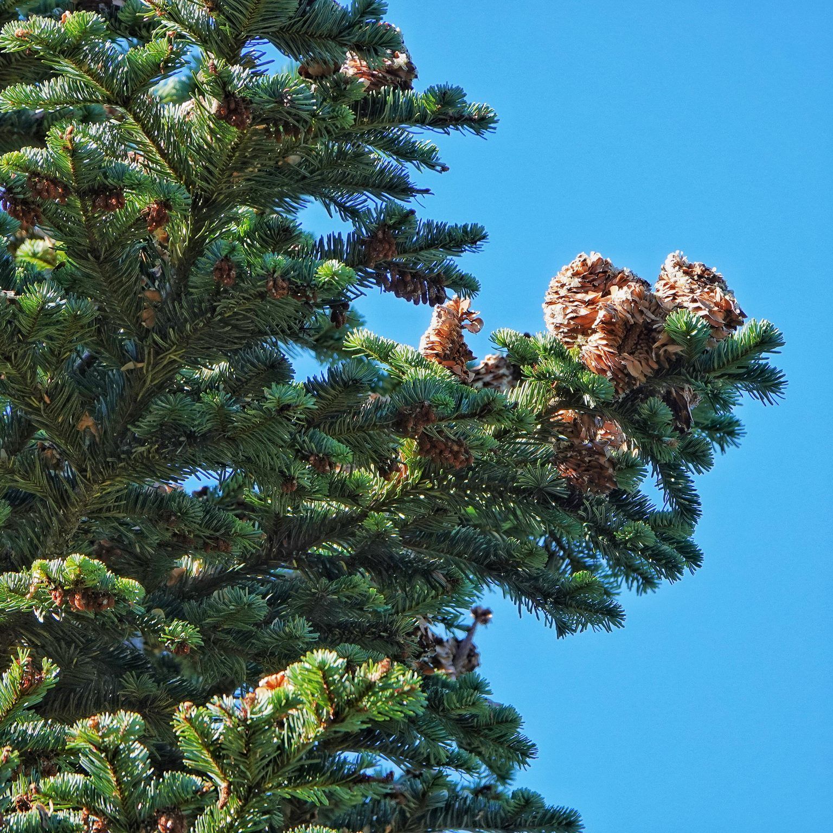
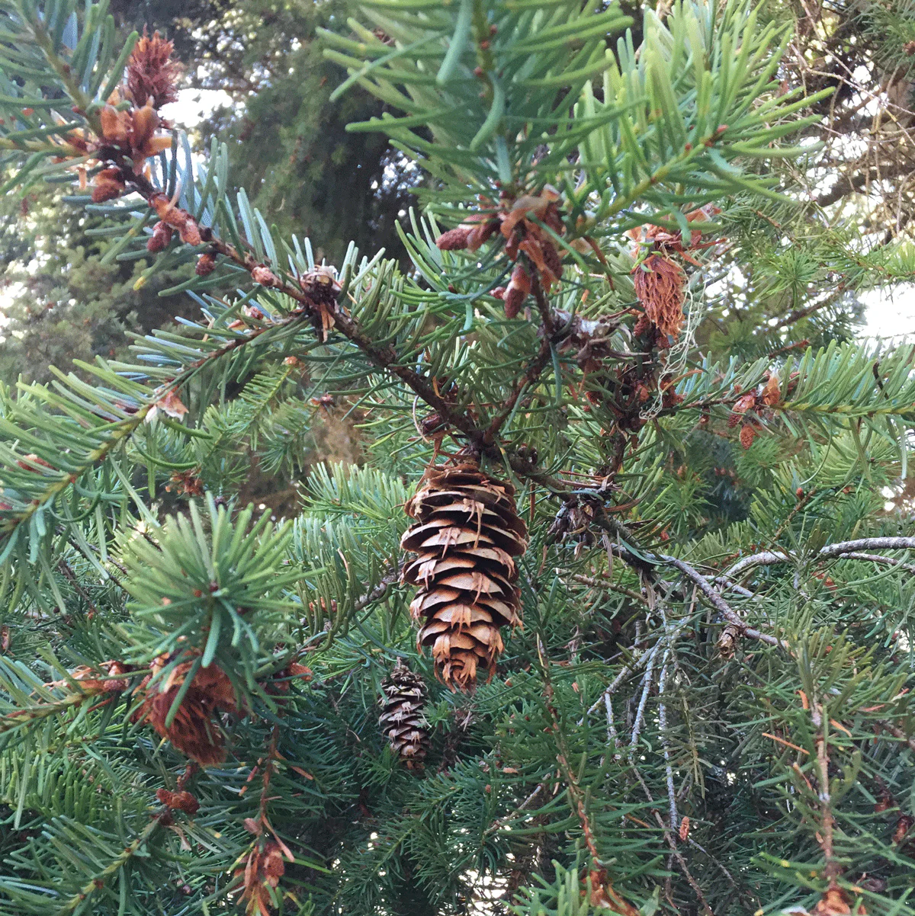
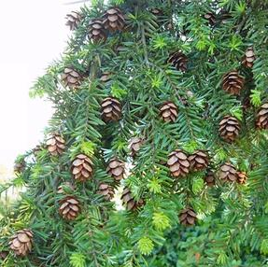
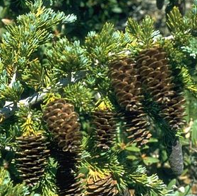
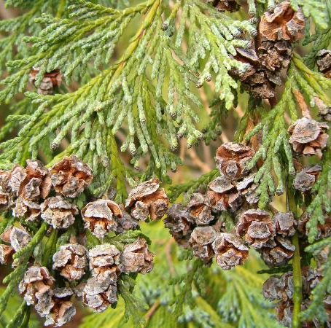
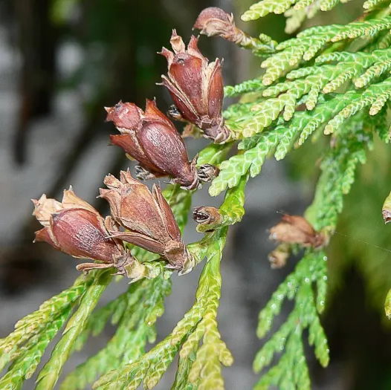
Source: iNaturalist
Abies amabilis
Pacific silver fir
Pseudotsuga menziesii
Douglas-fir
Tsuga heterophylla
Western hemlock
Tsuga mertensiana
Mountain hemlock
Callitropsis nootkatensis
Yellow cedar
Thuja plicata
Western Redcedar
‘Flower’ development | Early fall (1st) | Early fall (1st) | Early fall (1st) | Early fall (1st) | Early fall (1st) | Early fall (1st)
Pollination | Late spring to early summer (2nd) | Spring (2nd) | Early spring (2nd) | Late spring to early summer (2nd) | Late winter to early spring (2nd) | Early spring (2nd)
Fertilization | Late spring or early summer (2nd) | Late spring to early summer (2nd) | Late spring to early summer (2nd) | Mid to late summer (2nd) | Early to mid-spring (2nd) | Late spring (2nd)
Maturation | Summer through early fall (2nd) | Summer through early fall (2nd) | Summer through early fall (2nd) | Mid-summer to early fall (2nd) | Mid-summer (2nd) to fall (3rd) | Late spring to late summer (2nd)
Dispersal | Fall (3rd) | Fall (2nd) | Fall (2nd) | Fall (2nd) | Fall (3rd) | Fall (2nd)

Slide 10
Species with different reproductive cycles
Different elevation indicating different resources they can accumulate
Trade-off between the growth in the previous years, current year, following year of the masting years, which help us understand when does the masting initiate

Slide 11
Seed_{j,sp,y} ∼ NegBinomial(λ_{j,sp,y}, ϕ)
The modeled seed count (λ_{j,sp,y}) for stand j, species sp, and year y is:
log_{(λj,sp,y)} = α₀ + α_{sp} + α_{j} + β_{1,sp} ・ Growth_{j,sp,y} + β_{2,sp}・ Growth_{j,sp,y−1} + β_{3,sp} ・ Elevation_{j}

Slide 12
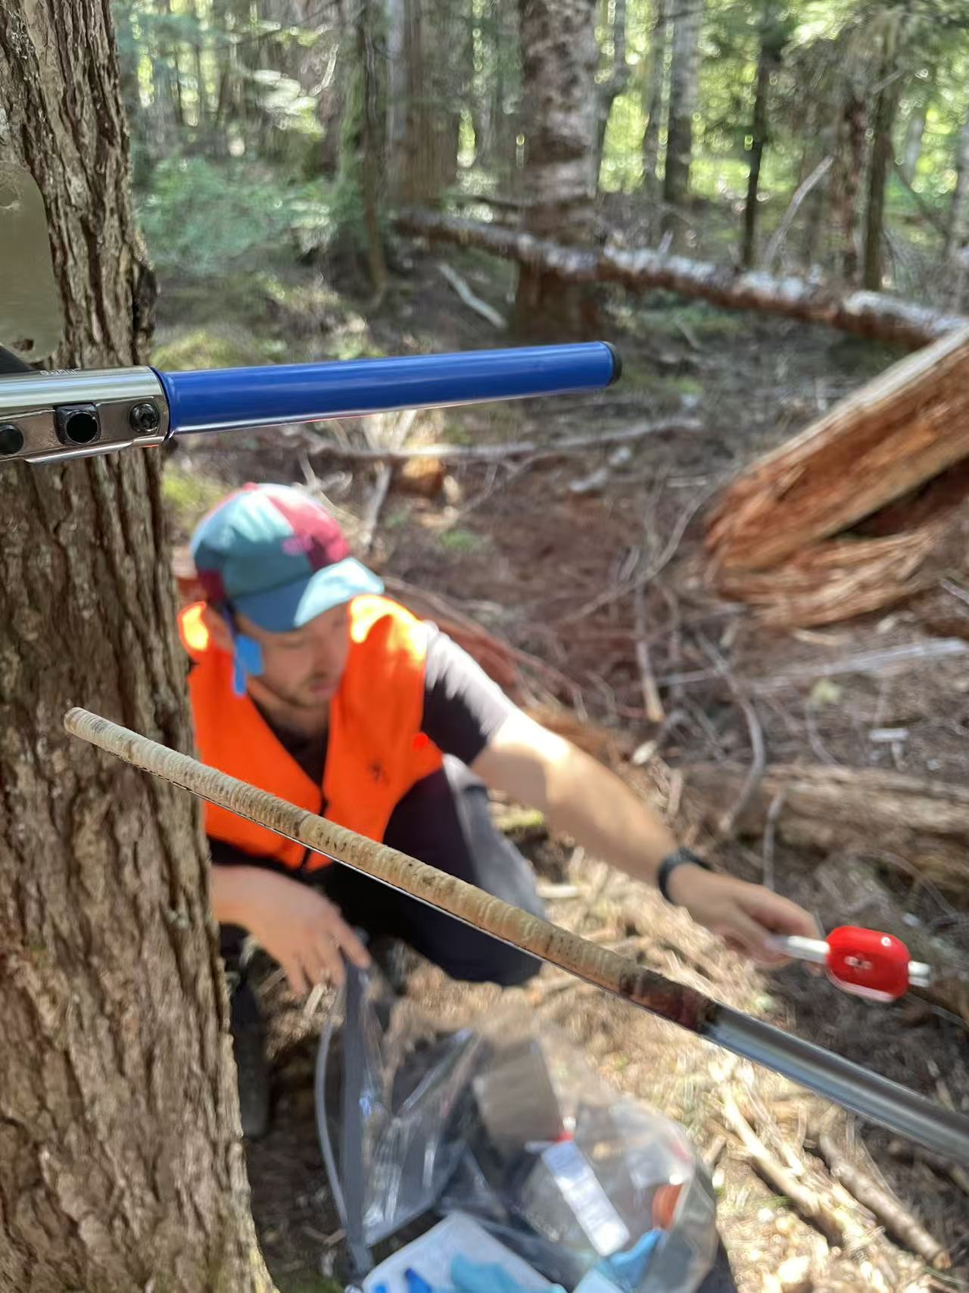



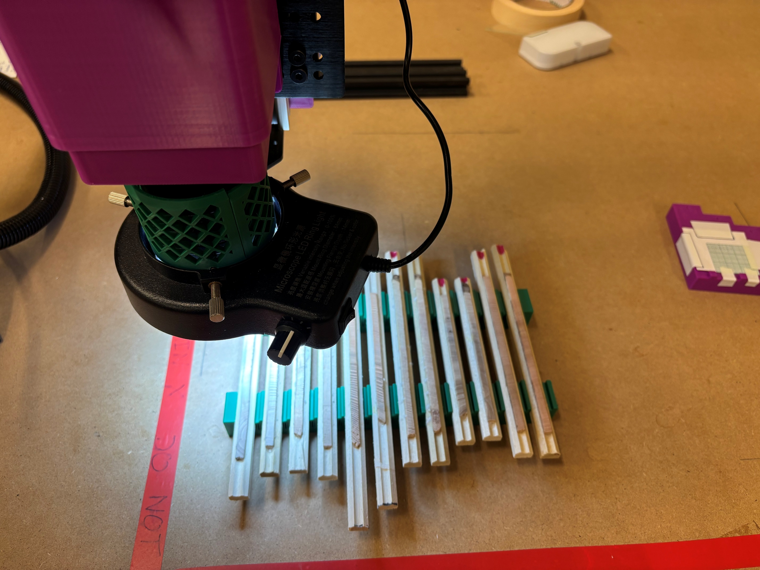
Coring √
Mounting √
Sanding 85% Done
Scanning
Measuring
Cross-dating
Analyzing

